Slide 1
Stereo Vision with Block Matching
Christopher Munroe
Undergraduate of Computer Science

Slide 2
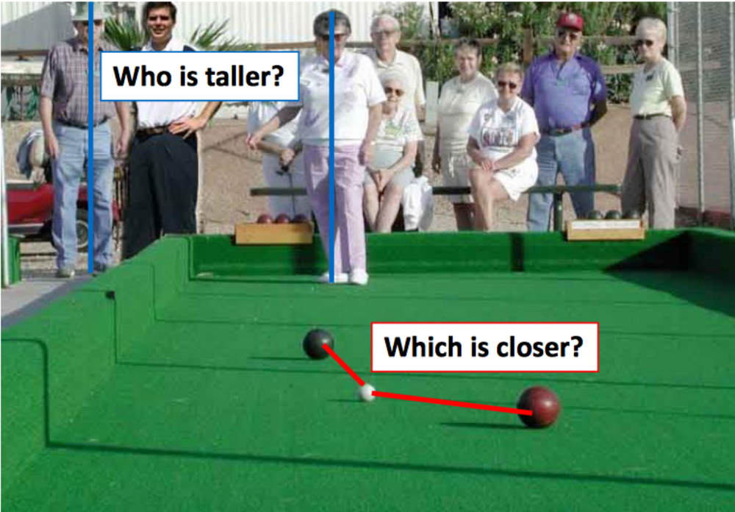
Introduction
How can depth be extracted from pictures?
Computers lack context.

Slide 3
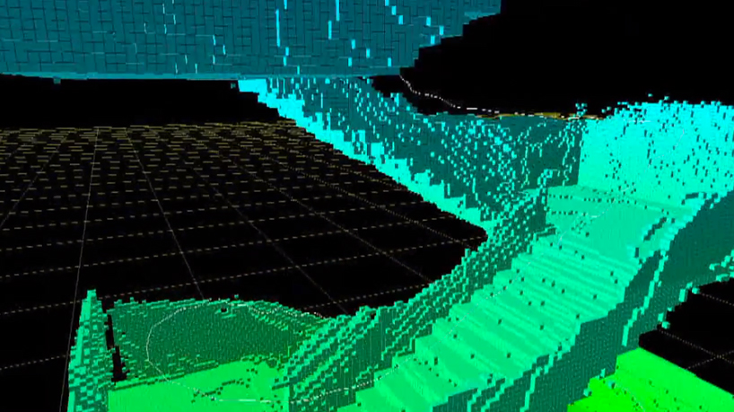
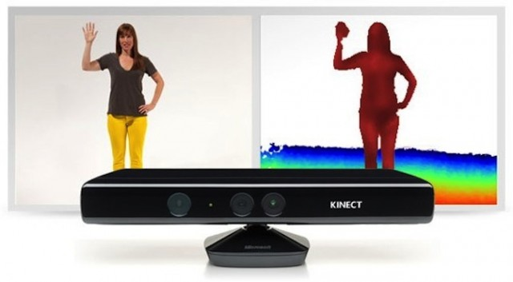
Motivations
Depth perception has many applications, including:
Robotics
3D mapping
Driverless cars
Home entertainment (Xbox Kinect)
Object segmentation

Slide 4
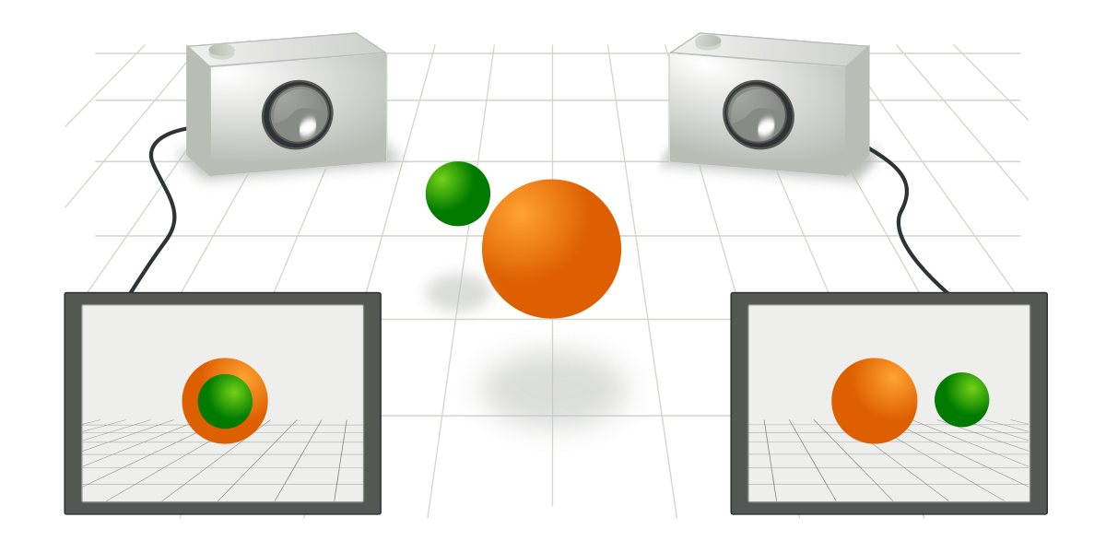
Basic Objectives
Know the cameras’ focal length, and relative orientation and focal length.
Pick a pixel in the first image and find the corresponding pixel in the other image.
Triangulate using the knowns

Slide 5
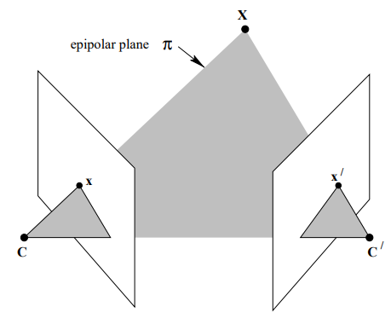
Theory - Epipolar Geometry

Slide 6
Theory - Epipolar Geometry
What if we don’t know x’?

Slide 7
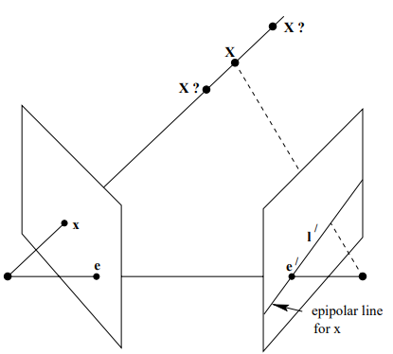
Theory - Epipolar Geometry

Slide 8
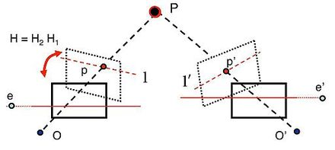
Theory - Image rectification

Slide 9
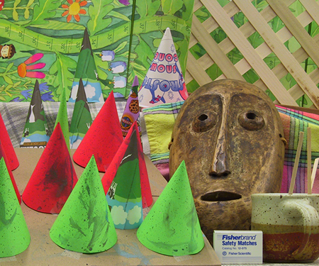
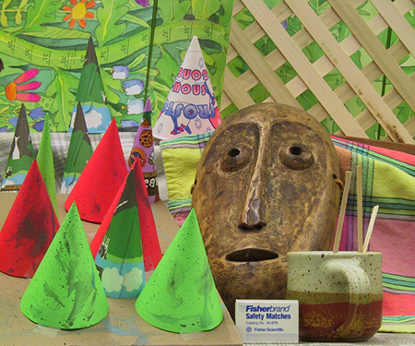
Block Matching Example
Left Camera
Right Camera

Slide 10

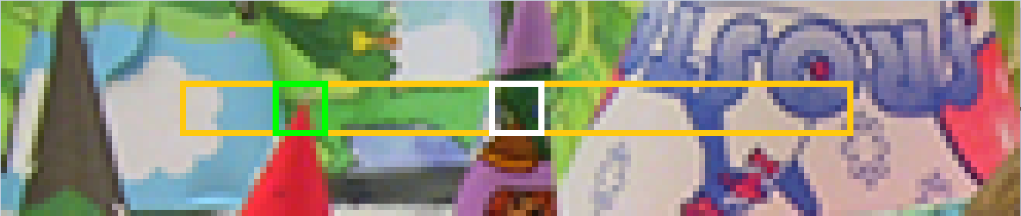
Block Matching Example

Slide 11
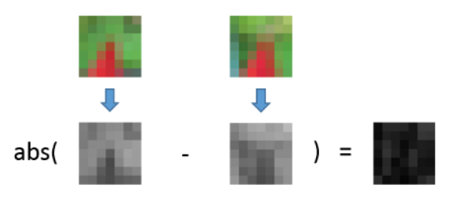
Comparison Function - SAD

Slide 12
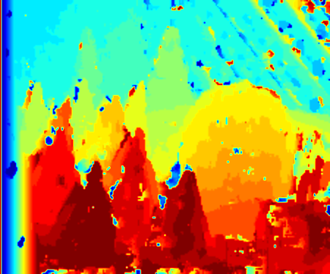
Final Result

Slide 13
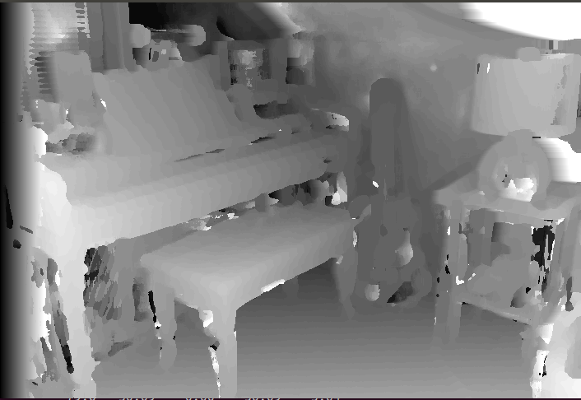
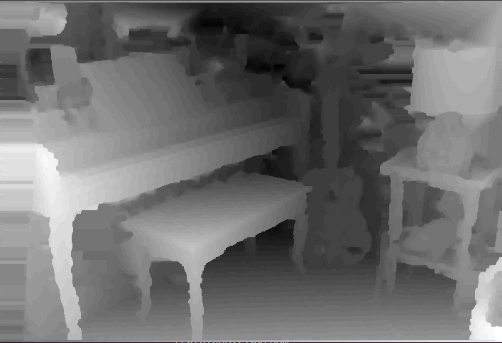
Evaluation
My algorithm
ELAS (state of the art)
Error: 37%
Time: 42 seconds
Error: 22%
Time: 0.14 seconds

Slide 14
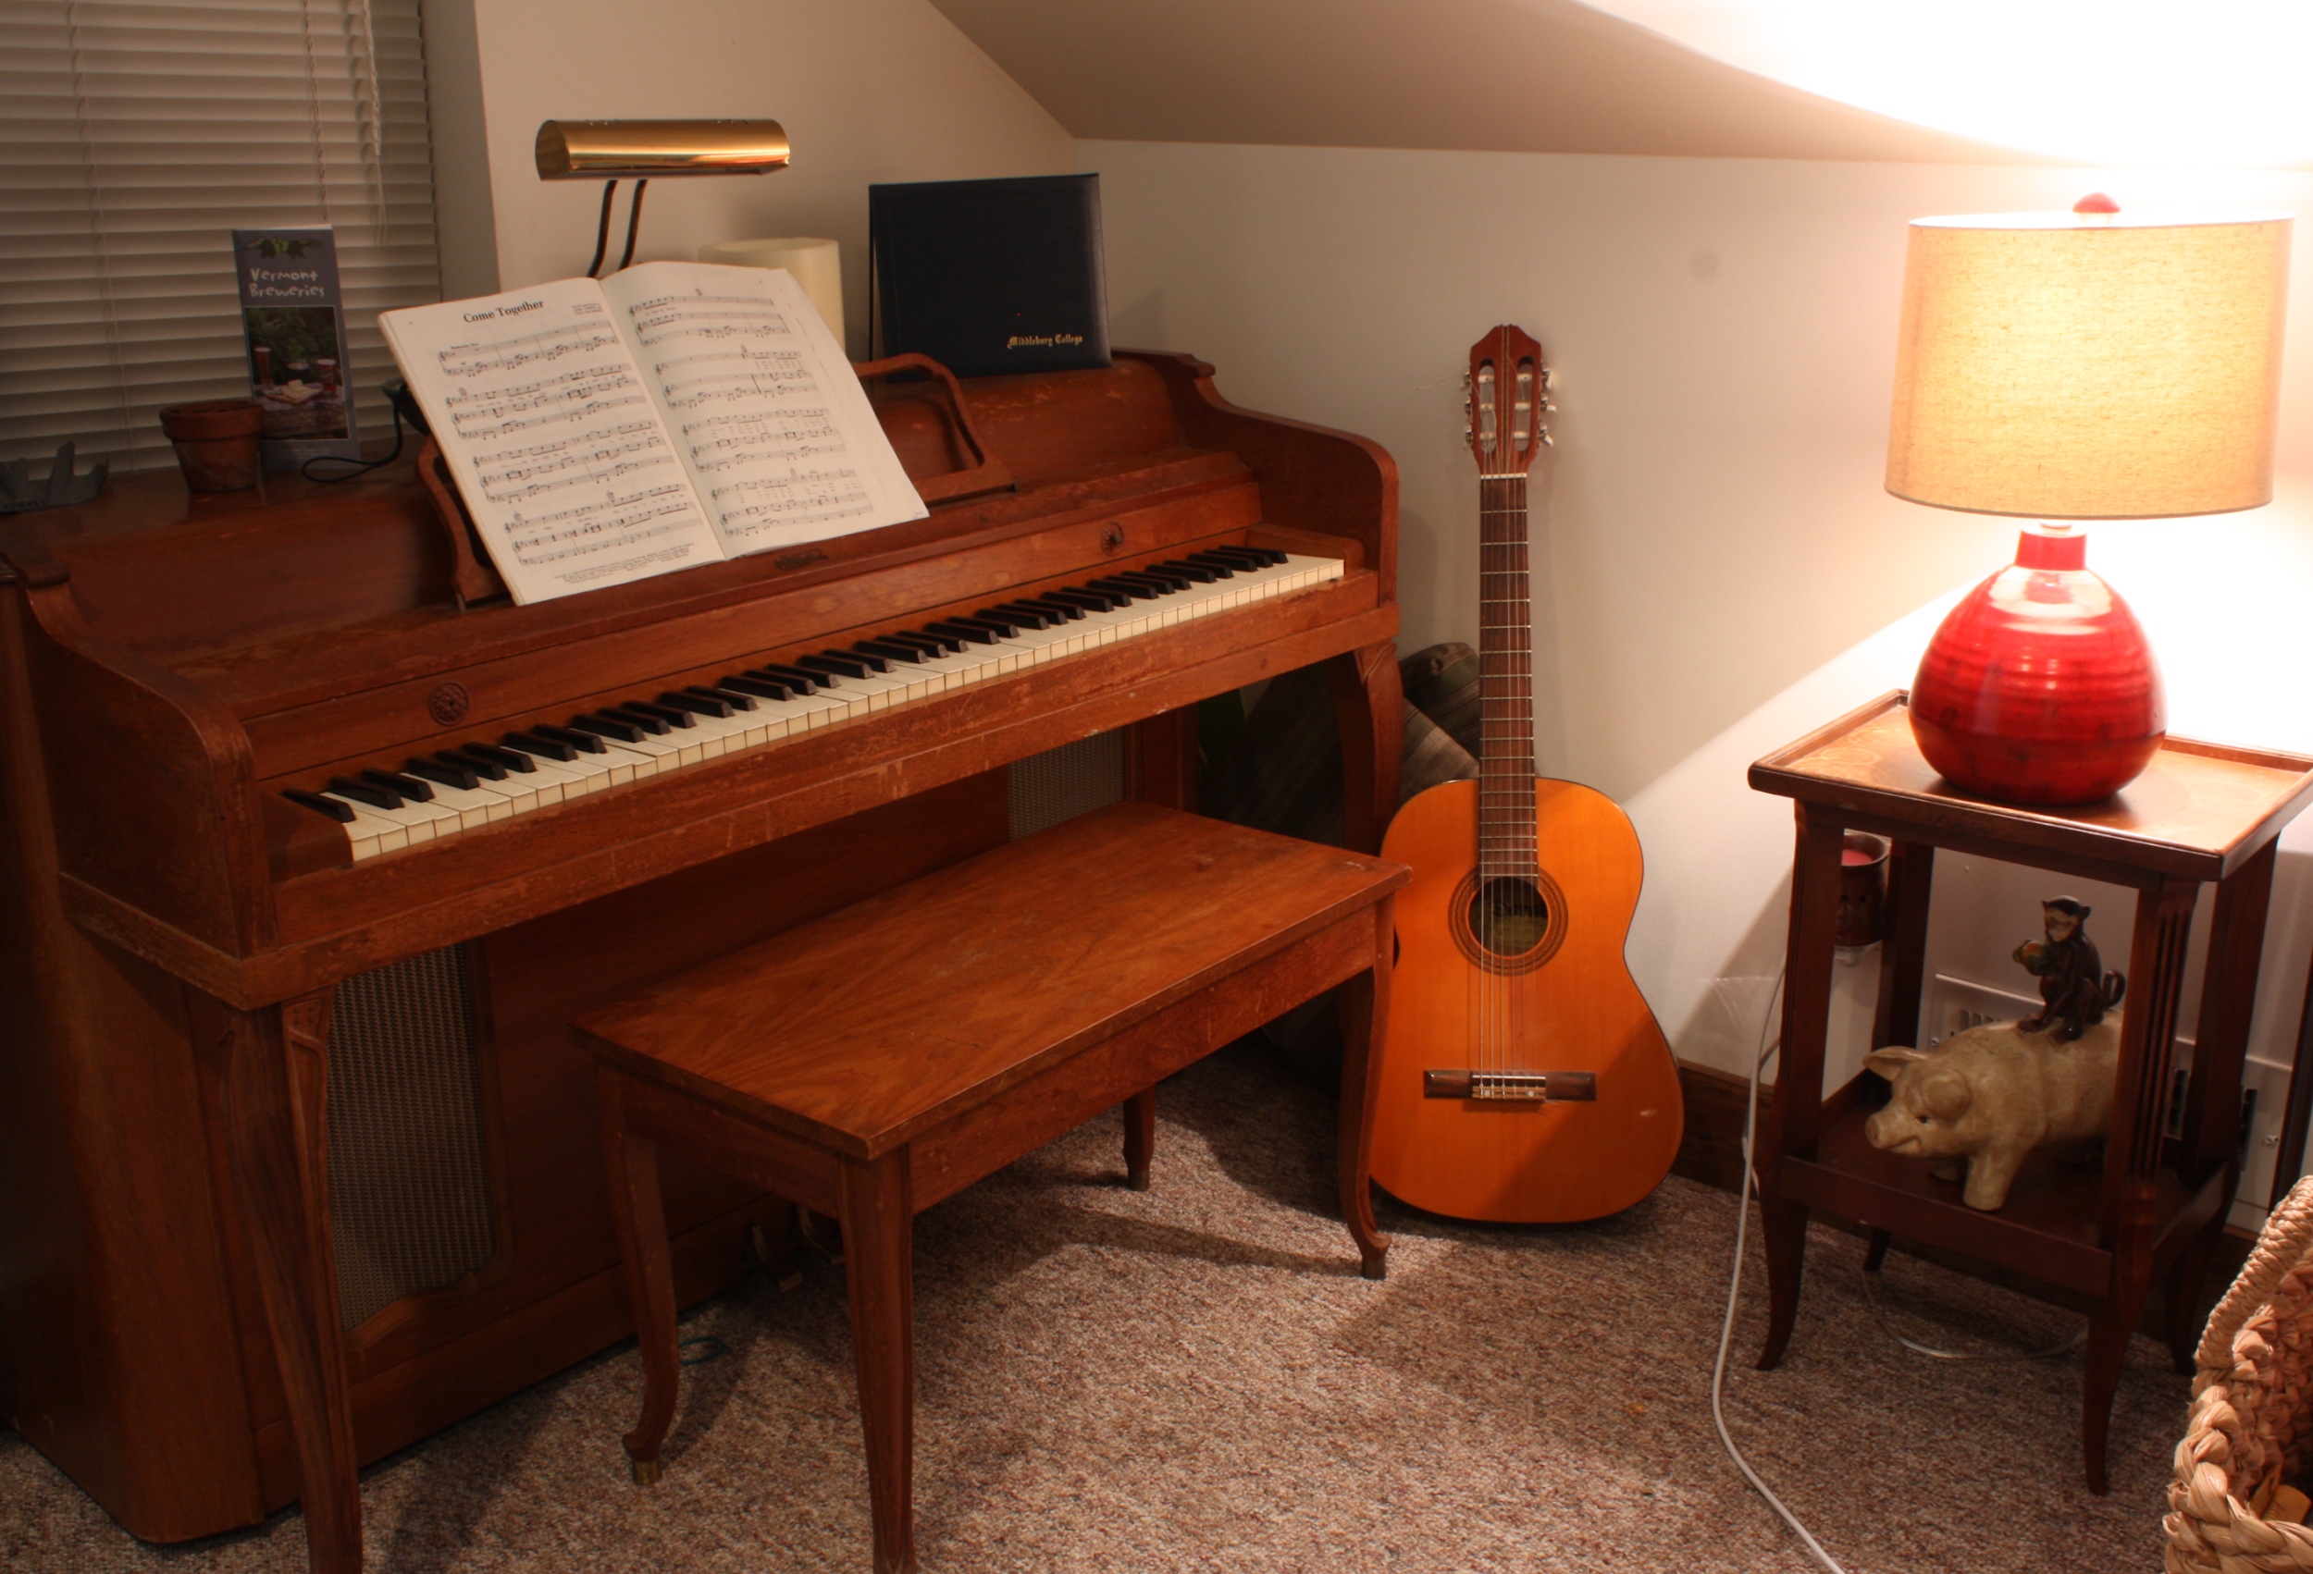
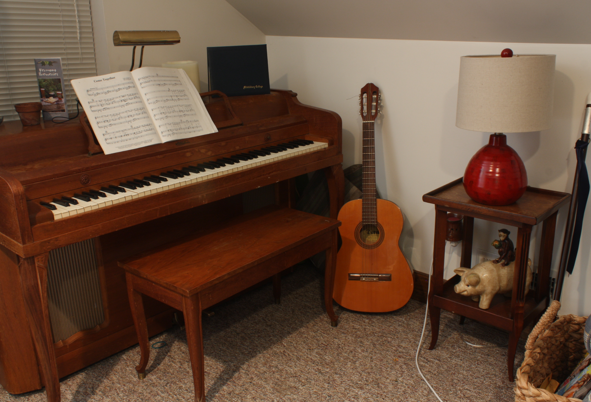
Shortcomings

Slide 15
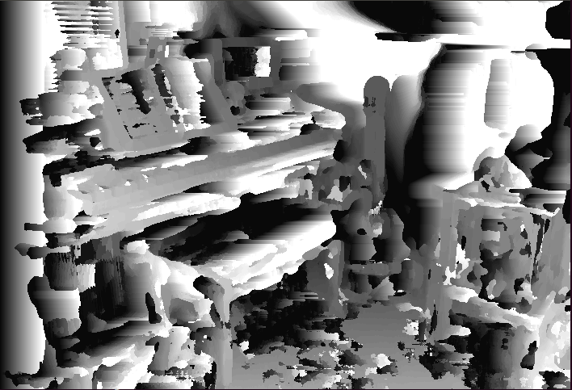
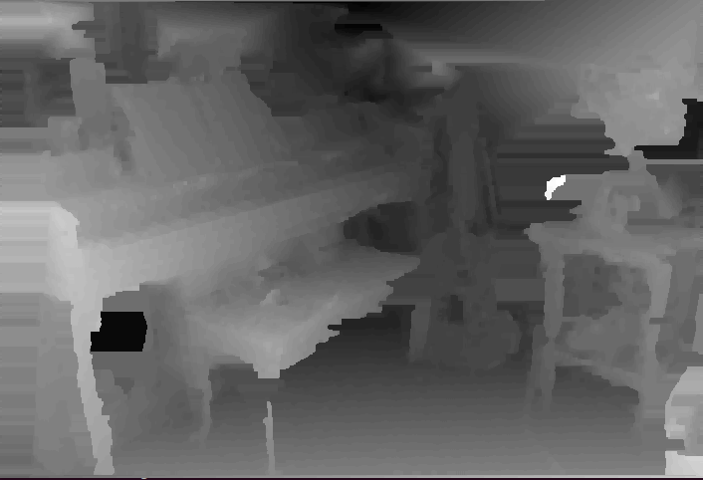
Shortcomings
My algorithm
ELAS (state of the art)
Error: 83%
Time: 41 seconds
Error: 37%
Time: 0.13 seconds

Slide 16
Implementation
Language: C++
Framework: OpenCV

